Slide 1

Craigslist.org Used Cars Search Tool
ISTE-610: Team 4
(Ian Brown, Kaarthik Sundaramoorthy, Anand Surya Rajasrinivasan and Stephen Ryan)

Slide 2

Agenda
Introduction
Database
Implementation, Importing and Preprocessing
Program Functionality
Framework Description
Search Demonstration
Geo Search Demonstration
Document View and Commenting
Project Constraints and Limitations
Conclusion
Questions
This Photo by Unknown Author is licensed under CC BY-NC-ND

Slide 3

Introduction
Data Source: “Used Cars Dataset: Vehicle listing from Craigslist.org”
Compiled by Austin Reese on Kaggle.com
https://www.kaggle.com/austinreese/craigslist-carstrucks-data
Collection of used cars listings scraped from Craigslist using a web application built with Python and Flask
Current version of data last updated March 22nd (the version used for this project)

Slide 4
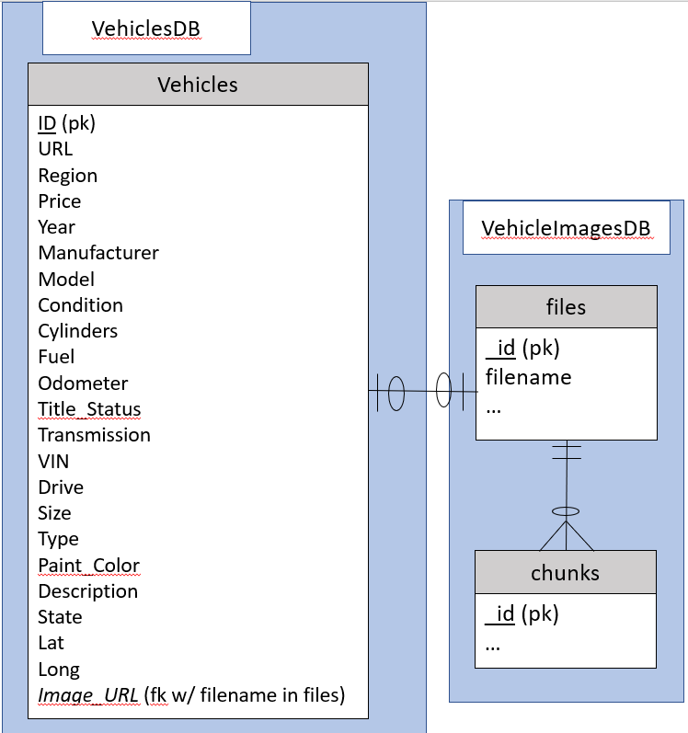
Database
Main MongoDB instance hosted on an Ubuntu server hosted on AWS
Data in VehiclesDB: Vehicles collection imported from csv
Number of records: 539759
Removed fields “county”, which was unused in the original dataset, and “region_url” which was determined redundant to “region”
Added “2dsphere” index for Geo search
Data in VehicleImagesDB imported from downloaded Craigslist Images derived from “Image_url” in the original dataset
Intended to be linked to Vehicles collection by “image_URL”
25 images currently downloaded
ER Diagram detailing the database design

Slide 5

Program Functionality: Framework
Web server hosted on Node.js, hosted on the same AWS Ubuntu server
Provides connection between web frontend and MongoDB backend
Earlier attempt considered with PHP, abandoned due to driver difficulties
Implements a partial MEAN stack: MongoDB, Express.js and Node.js, but Angular is not used
HTML and frontend JavaScript designed in-house

Slide 6
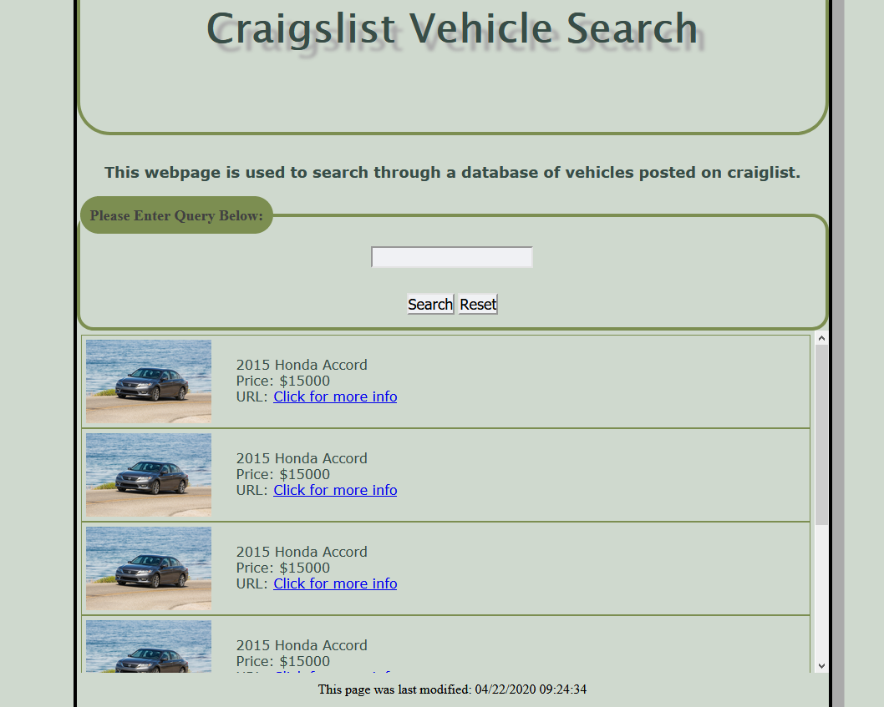
Program Functionality: Search
Search process:
Allows user to search by year, manufacturer, or model
Search returns 20 results with Picture, Year, Make, Model, Price, and a “Click for more info” option for result of query
Original intention was to show picture for each car
Instead: images chosen randomly from GridFS file database as placeholders
“Reset” button clears input box
Live demonstration
Original Intended Search View

Slide 7

Program Functionality: Geo Search
Geo search functionality implementation:
Two parameters: location and proximity in miles
Uses “2dsphere” location index model
‘Rochester, NY’ and ‘5’ returns 10 listings within a 5-mile radius of Rochester, NY
Live Demonstration
This Photo by Unknown Author is licensed under CC BY-SA

Slide 8
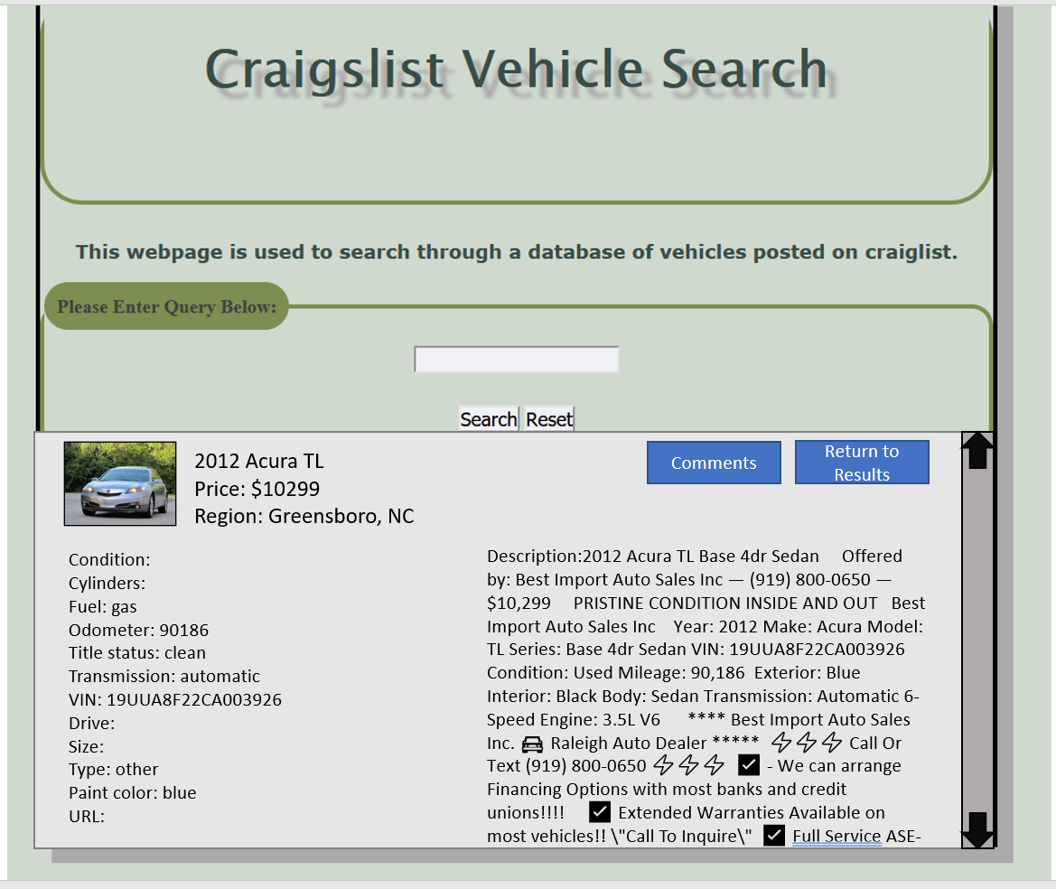
Program Functionality: Document View and Commenting
“Click for more info” option opens Document view
Shows all information on listing including description
“Comments” section: user can post a comment on a vehicle which is stored with on the database and retrieved when the document is reloaded
Live demonstration
Original Intended Document View

Slide 9

Project Constraints and Limitations
AWS Instance:
Storage went beyond free allowance
Hosting time limited: 85% of free uptime already used by near project completion
Database:
GridFS image storage limited to 25 images to conserve on AWS space usage
Confusion about project requirements let to hosting of app on same server as MongoDB database
Program Functionality:
Time constraints led to some features being cut/reworked (e.g. pictures per document, multiple comments, original layouts)
Search by tag- considered, but left out
Communication complications:
COVID-19 provisions made in-person meetings impossible
Google Hangouts and Google Drive used to share information and files- often slow development process
This Photo by Unknown Author is licensed under CC BY-SA

Slide 10

Conclusion and Future Work
Conclusion:
First time we have used Node.js for development
Demonstrates the potential for application development with MongoDB
Future Work:
Allow application to connect to separate MongoDB server
Fix GridFS and comment implementation
Expand storage and download all images to GridFS DB
Allow more robust search
Implement a “drop-pin” map-based Geo search capability
Implement other cut features

Slide 11
Questions?
Thank you!
2020 ISTE-610 2195 Team 4

